Slide 1
INTERNSHIP PROJECT
Entertainment Industry & India Rainfall Analysis
Presented By,
Mentored By,
MADESH M,
II - M.Sc. Data Science,
Dept of Computer Science,
Periyar University.
Ms. R SAMYA,
Teaching Assistant,
Dept of Computer Science,
Periyar University.

Slide 2
Overview of the Internship Project:
Internship Details:
Internship Title: Data Visualization with Tableau Internship
Company: Cognitive i IT Solutions (P) Ltd, Salem
Objective: Gain practical experience in data analysis and visualization using Tableau.

Slide 3
Project overview:
During this internship project, I developed two distinct datasets for analysis:
Entertainment Industry Analysis
Focus: Identifying trends in budget allocation, movie releases, and the correlation between ratings.
Purpose: To provide insights for strategic decision-making for a movie review company.
Outcome: Uncovered patterns that influence financial performance and audience reception in the entertainment sector.
India Rainfall Analysis
Focus: Investigating long-term trends, seasonal variations, and state-wise distribution of rainfall.
Purpose: To examine the impacts of climate change and detect extreme weather events.
Outcome: Provided valuable insights into regional weather patterns, aiding decisions related to agriculture, disaster preparedness, and climate adaptation.
Objective: Both analyses aimed to deliver actionable insights using data-driven approaches, supporting decision-makers with evidence-based findings.

Slide 4


ENTERTAINMENT INDUSTRY ANALYSIS

Slide 5
Objective
This project an analysing of movie rating (by audiences and cities rating). Movie budgets, and the number of movies released under various genres from the years 2007 and 2011. the analysis aims to uncover in budgets allocation, movie releases, and rating correlation to support strategic decision-making for the movie review company.

Slide 6
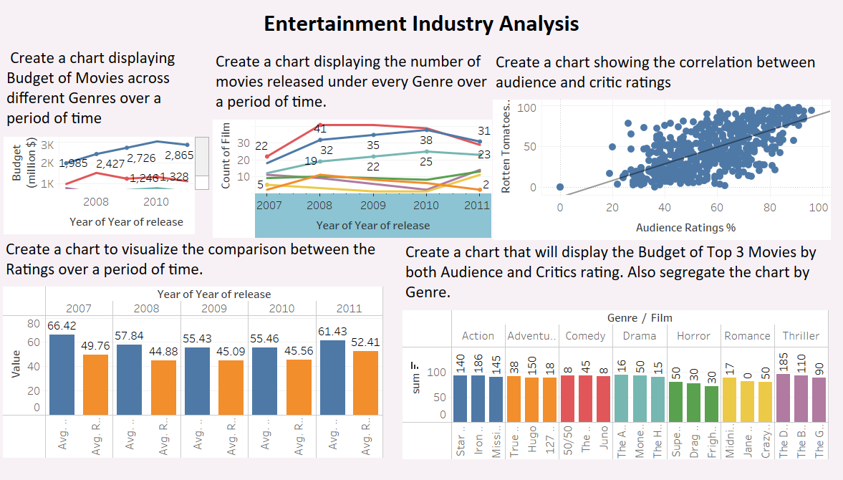
DASHBOARDS
Link: Free Data Visualization Software | Tableau Public

Slide 7
Summary
Action and Adventure genres dominate in terms of budget and movie releases over time.
Audience ratings are generally higher than critic ratings, but both fluctuate over the years.
Top 3 movies in the Action and Adventure genres have much larger budgets compared to other genres, with Comedy and Romance films being produced on significantly smaller budgets.

Slide 8

INDIAN RAIN ANALYSIS

Slide 9
Objective:
The Indian rainfall analysis aims to identify trends and variations in regional rainfall patterns, assess their impact on agricultural productivity, and evaluate their relationship with water resource management. It seeks to provide actionable insights for policymakers to enhance disaster management and climate resilience. Ultimately, the analysis supports informed decision-making in agriculture and infrastruacture planning, contributing to sustainable development.

Slide 10
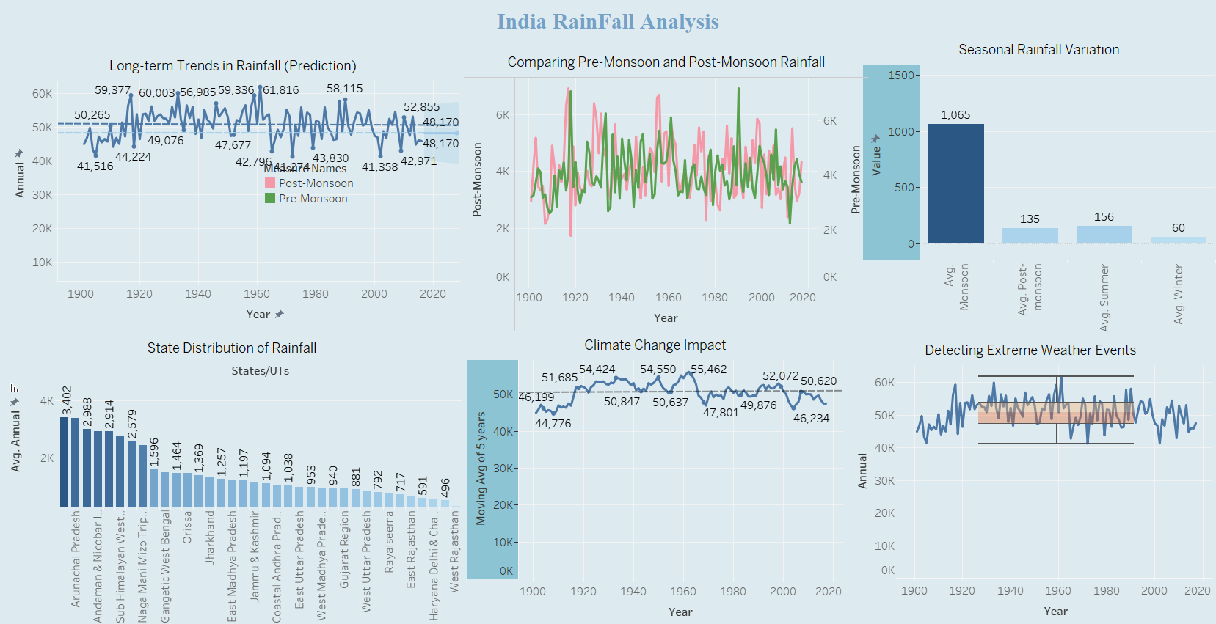
DASHBOARD
Link: India Rain Analysis | Tableau Public

Slide 11
Summary
Long-term trends in rainfall suggest some decline in annual precipitation levels post-1960.
The monsoon season is the dominant source of rainfall, with wide variations across different regions.
Coastal and hilly regions receive the highest rainfall, while arid areas like Rajasthan receive the least.
There’s a detectable impact of climate change, with more extreme weather events and shifting patterns in rainfall across decades.

Slide 12
Conclusion:
Created interactive dashboards to effectively present data insights.
Gained experience in data-driven decision-making and advanced technical skills in data visualization with Tableau during my internship at Cognitive IT Solutions (P) Ltd.
Enhanced abilities in data cleaning and storytelling while working with complex datasets.
Created interactive dashboards to effectively present data insights.
Planning to apply these skills to projects like Entertainment Industry Analysis and Rainfall Analysis for India.
Aiming to provide insights that support informed decision-making in agriculture and resource management.

